Slide 1
2P8 The Engineer in Business
Lecture 1
The theory of the firm

Slide 2
The Engineer in Business
3 lectures on economics
- The theory of the firm
- The growth of the firm
- The regulation of the firm
2 lectures on strategy
3 lectures on marketing
Multiple choice questions in exam
(see 2019 past paper and cribs for current format; 2021- 2023 exams on VLE)
See notes for my lectures (all my material is now on VLE)
Reading for my lectures:
Sloman, J., Garrett, D., Guest, J. and Jones, E. (2019, 2023), Economics for Business, 8th , 9th Edition, Pearson: chapters 3, 13, 15, 20 and 21.
2

Slide 3
The Theory of the Firm
So, you want to be in an engineer in business, but what do businesses do?
Questions:
1. Why do firms exist (what do they do)?
2. What determines their size and features?
3. What determines the boundary between the firm and the market?
Plan for today:
- Some empirical evidence about UK firms
- Variety of theoretical perspectives

Slide 4
A brief empirical overview of UK firms (Size, activity, age)

Slide 5
Population of UK Businesses
Source: Department Business and Trade
BUSINESS POPULATION ESTIMATES FOR THE UK AND THE REGIONS 2023, Statistical Release October 2023.
5

Slide 6
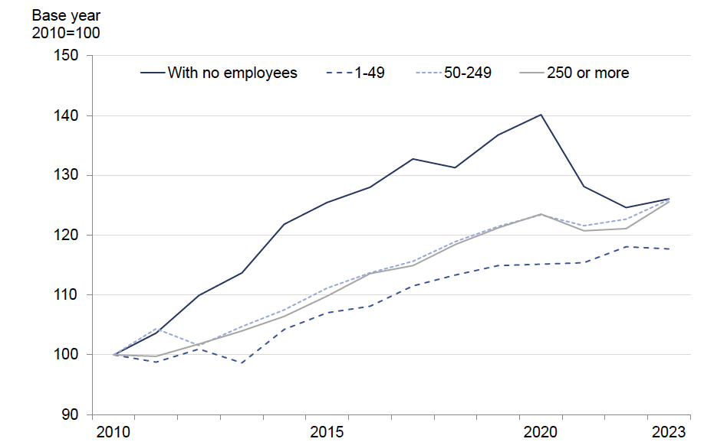
Number of Private Firms in the UK by size class (2010-2023)
Source: Department Business and Trade
BUSINESS POPULATION ESTIMATES FOR THE UK AND THE REGIONS 2023, Statistical Release October 2023.
6

Slide 7
Number of businesses by industry in the UK
Source: Dept Business and Trade
Business Population Estimates 2023, Table 29.
7

Slide 8
Dimension: Age of the firm
Source: https://www.merchantsavvy.co.uk/uk-sme-data-stats-charts/
8
Notes:
R-code:
tt<-read.table("clipboard")
image(t(as.matrix(tt)[dim(tt)[1]:1,]),axes=F)
box()
axis(3,at=(0:10)/(dim(tt)[2]-1),labels=1995:2005)
axis(2,at=(0:19)/(dim(tt)[1]-1),labels=seq(120,6,-6),las=1)
ttm<-tt
ttm[is.na(ttm)]<-""
for(i in 19:0){
text((0:10)/(dim(tt)[2]-1),i/(dim(tt)[1]-1),ttm[20-i,])
}

Slide 9
Theories of the firm

Slide 10
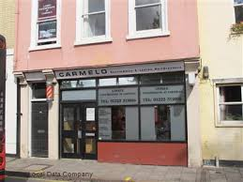



Types of Firm
A firm is an organisation consisting of one or more individuals working as a decision-making unit to produce goods or services.
Private sector firms
Unincorporated Businesses
Sole proprietors e.g. hairdressers, corner shops
Partnerships e.g. lawyers, accountants
Incorporated Businesses
Private limited company e.g. Virgin
Public limited company e.g. ITV, Shell
Public sector firms, e.g. The NHS (?)

Slide 11
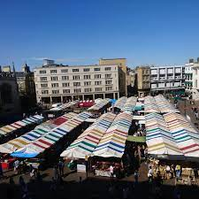
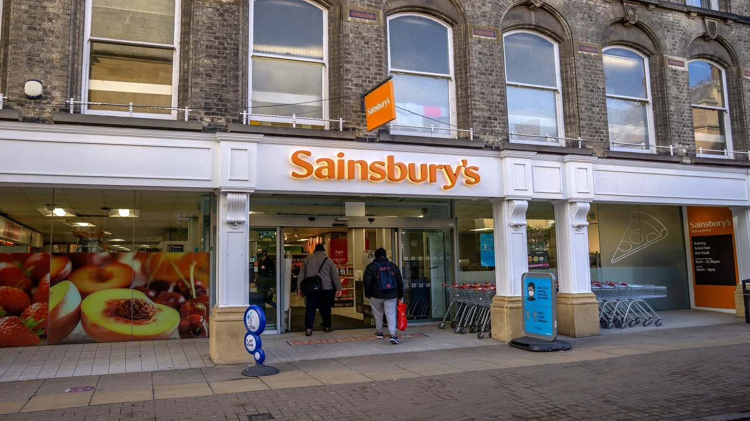
Could organize production in the firm or via the market
‘The market is an institution for resource allocation which is based on horizontal voluntary exchanges by individual economic agents, who are motivated by preferences and price signals.’
Adapted from Pitelis (1999)
vs
11

Slide 12
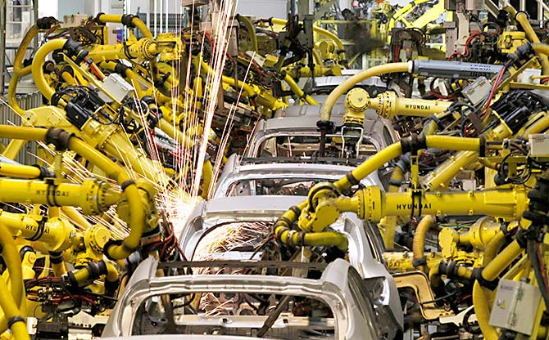
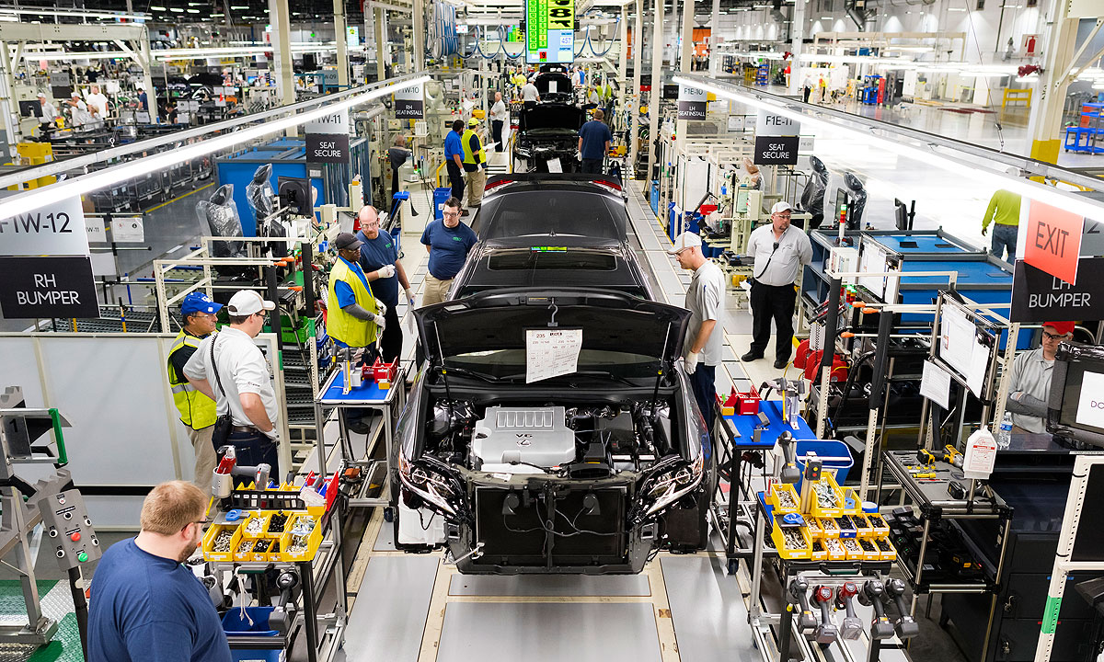
The firm in neoclassical theory
Capital, K
Q=K^{0.5}L^{0.5}
0
Labour, L
Q=quantity of cars, K=quantity of capital, L=quantity of labour
12

Slide 13
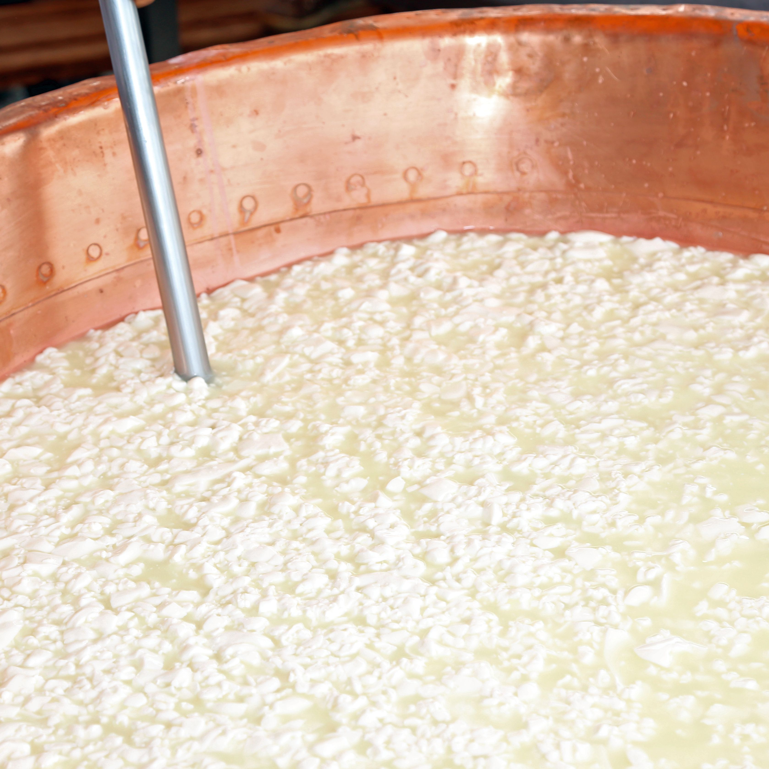
Compare and contrast…
The firm is:
‘An island of conscious power in this ocean of unconscious co‐operation, like lumps coagulating in a pail of buttermilk’
Dennis Robertson (1923)
13

Slide 14
The Neoclassical View of the Firm
The firm can be reduced to a mathematical construct.
This is ‘convenient’ because it allows modelling of the determination of behaviour (e.g. output choices) under specific assumptions.
It also helps the modelling of firm strategies under different types of market structure and specific assumptions (equilibrium framework).
What determines its size?
Technology/input prices
Economies of scale
Pursuit of ‘profit maximizing’ size
Potential problems of market power
Problems:
Doesn’t ask which activities will be mediated within firms rather than between them → Why do firms exist at all?
It treats the firm as a ‘black box’ (what happens inside the firm?).
Pervasive assumption of rationality (+ perfect information).
14

Slide 15
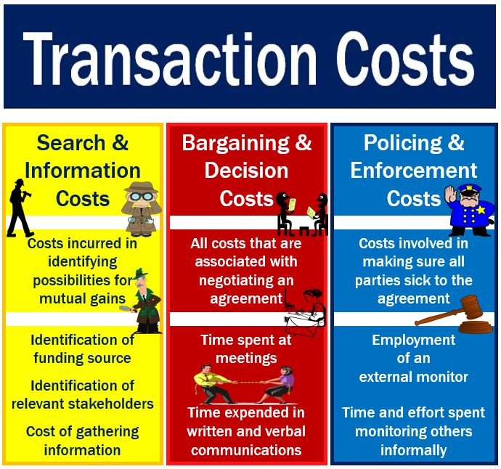
Transactions Costs
Transactions costs are the cost of discovering prices and the cost of negotiating and concluding prices as well as making and enforcing contracts.
Treat firm and market as ‘alternative’ ways of carrying out transaction processes
Fundamental intuition: if markets are efficient resource allocators, why don’t entrepreneurs just contract for everything through the market? Ans: Because there are transaction costs.
“A firm consists of the system of relationships which comes into existence when the direction of resources is dependent on an entrepreneur.” (Coase, 1937)

Slide 16
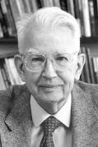
The Transactions Cost View of the Firm (Coase, 1937)
The firm is characterised by an authority structure (a hierarchy) and incomplete contracts.
Uncertainty leads to incomplete contracts; uncertain terms may be decided in the future by one party in a long-term contract (e.g. purchaser directs supplier).
The alternative to this is the market which has complete contracts with legal force.
Firms have flexibility of response in conditions of uncertainty about the future.
What determines the size of the firm?
The point where the cost of internal organisation of a transaction and external organisation are equal.
1991
Nobel prize
winner
16

Slide 17

The Transactions Cost View (2)
Why is all production not in one firm?
Transactions are spatially dispersed.
Transactions are dissimilar.
Costs of intervention rise over time.
Size implies market power and hence regulation.
Coasean view is that in capitalism the economically efficient amount of hierarchy emerges.
Critique:
Authority is not the essence of the firm; loyalty and identification may be more important.
Market transactions not just contract based: trust matters
Firm is about more than the transaction: what generates whatever it is that is transacted?
17

Slide 18

The Property Rights View
18
“In a world of transaction costs and incomplete contracts, ex post residual rights of control will be important because, through their influence on asset usage, they will affect ex post bargaining power and the division of ex post surplus in a relationship. This division in turn will affect the incentives of actors to invest in that relationship.”
Hart, O. (1989). An economist’s perspective on the theory of the firm. Columbia Law Review 89(7), p.1766

Slide 19


The Property Rights View (2)
Set in a world with transactions costs and incomplete contracts.
Ownership matters because it carries residual control rights to take decisions in unpredicted/uncontracted for situations (Hart and Moore, 1990).
Ownership reduces the possibility of returns to particular investments being partially appropriated by other firms.
Thus particular collections of assets (firms) may represent the optimal trade‐off between operational and investment incentives.
Example: GM acquisition of Fisher Body (1920s) –complementary/specific assets should be under joint ownership.
Problem: separation of ownership and control.
19

Slide 20
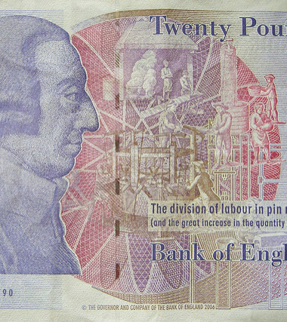
The Marxist View of the Firm
The rise of the factory system may be seen as an attempt by factory owners to gain control over the production process in order to extract a larger share of the value added in production (Marglin, 1974).
In this sense transactions cost view of the firm as a hierarchy and Marxist view are similar.
BUT purpose is not ‘efficiency’ but exploitation.
This view suggests that firms may develop in ways designed to shift the distribution of value rather than to improve efficiency.
Conflicts of interest between owners/workers (capital vs. labour).

Slide 21
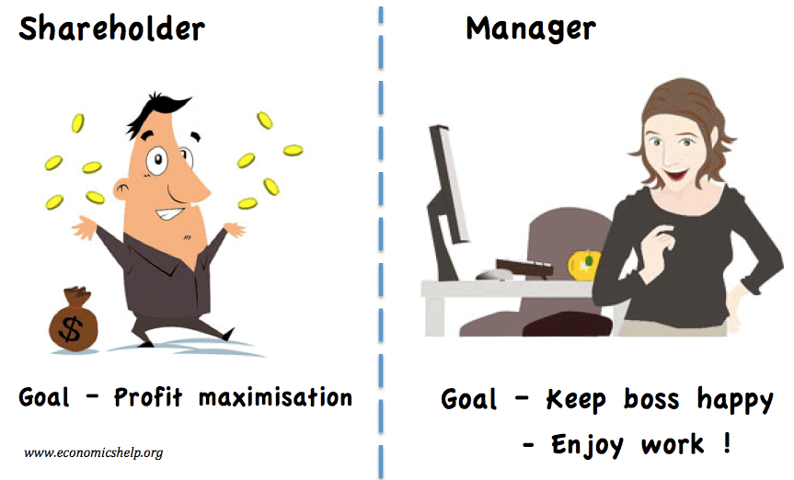
Managerial Theories of the Firm
Rise of the ‘Modern Corporation’
Dispersed shareholdings
Separation of Owners and Managers
Berle & Means (1932) The Modern Corporation and Private Property
Marris (1963) The Economic Theory of Managerial Capitalism
→ Pursuit of managerial vs. shareholder objectives (managers maximise their own welfare, i.e. principal-agent problem)
Sales maximisation (Baumol, 1959)
Slack maximisation (Williamson, 1964)
Growth maximisation (Marris, 1963)
21

Slide 22

Behavioural Theories of the Firm
Behavioural theories of the firm suggest that:
Bounded rationality and uncertainty make optimisation impossible
Organisations have multiple objectives reflecting interest groups in organisation (setting of targets)
Managers reconcile the competing objectives of interest groups within the firms subject to a ‘satisfactory’ level of profits (Cyert and March, 63).
The need to adjust to an uncertain environment may lead to organisational slack
Firms engage in gift exchange with workers: workers supply effort in return for fair treatment (Akerlof, 82).
22

Slide 23
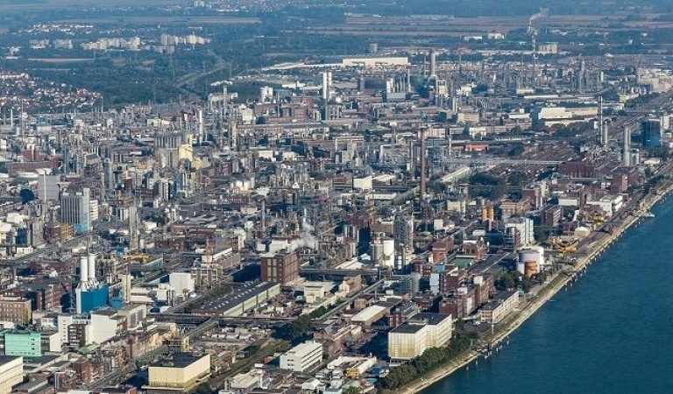
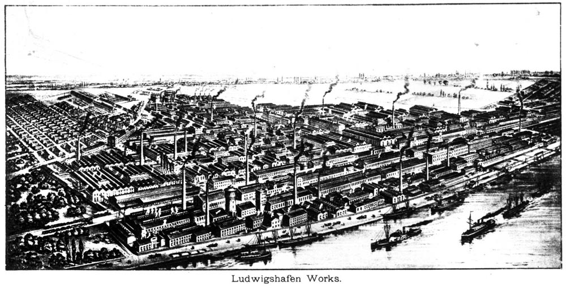
The Capabilities Approach to the Firm
The modern capitalist firm exists because it ‘knows’ how to do certain things, and can exploit this ability (Chandler, 1992).
Those capabilities may reflect/arise from core competencies based on:
Management skill
History in the industry
Specific assets (tangible and intangible)
A particular location
Capabilities generate competitive advantage
BASF
site at:
Ludwigshafen
since 1865
23

Slide 24
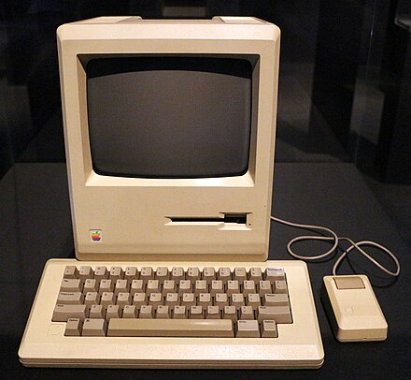
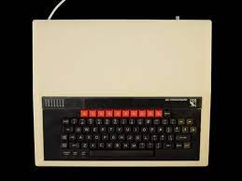
Evolutionary Theories of the Firm (Nelson and Winter, 1982)
Dis-equilibrium, as opposed to equilibrium approach…
Bounded-rationality (as in behavioural theories)
Population dynamics and firm heterogeneity (‘fitness’)
Competition as a process → Variation, Selection and Retention mechanisms (Schumpeterian creative destruction)
Innovation-driven structural change (‘dynamic’ capabilities)
24
vs

Slide 25
Reading for today
Sloman, J., Garrett, D., Guest, J. and Jones, E. (2019, 2023), Economics for Business, 8th , 9th Edition, Pearson:
Chapters 3 (Business Organisations) and 13 (Alternative Theories of the Firm)
Available online on iDiscover

